Slide 1
Assess Landsat 5 based aquaculture classifications for
AP_3_01747900 – 1993, 1994, 1995
AP_4 – 1993, 1994, 1995
OD_1_01451900 – 1996, 1997, 1998
OD_3 - 1996, 1997, 1998
OD_4 - 1996, 1997, 1998
OD_5 - 1996, 1997, 1998
TN_2 – 2008, 2009, 2010
TN_3 - 2008, 2009, 2010
TN_4 – 1990, 1991, 1992
TN_5 – 1990, 1991, 1992
Year | District code
1990 | TN_4, TN_5
1991 | TN_4, TN_5
1992 | TN_4, TN_5
1993 | AP_3, AP_4
1994 | AP_3, AP_4
1995 | AP_3, AP_4
1996 | OD_1, OD_3, OD_4, OD_5
1997 | OD_1, OD_3, OD_4, OD_5
1998 | OD_1, OD_3, OD_4, OD_5
2008 | TN_2, TN_3
2009 | TN_2, TN_3
2010 | TN_2, TN_3

Slide 2
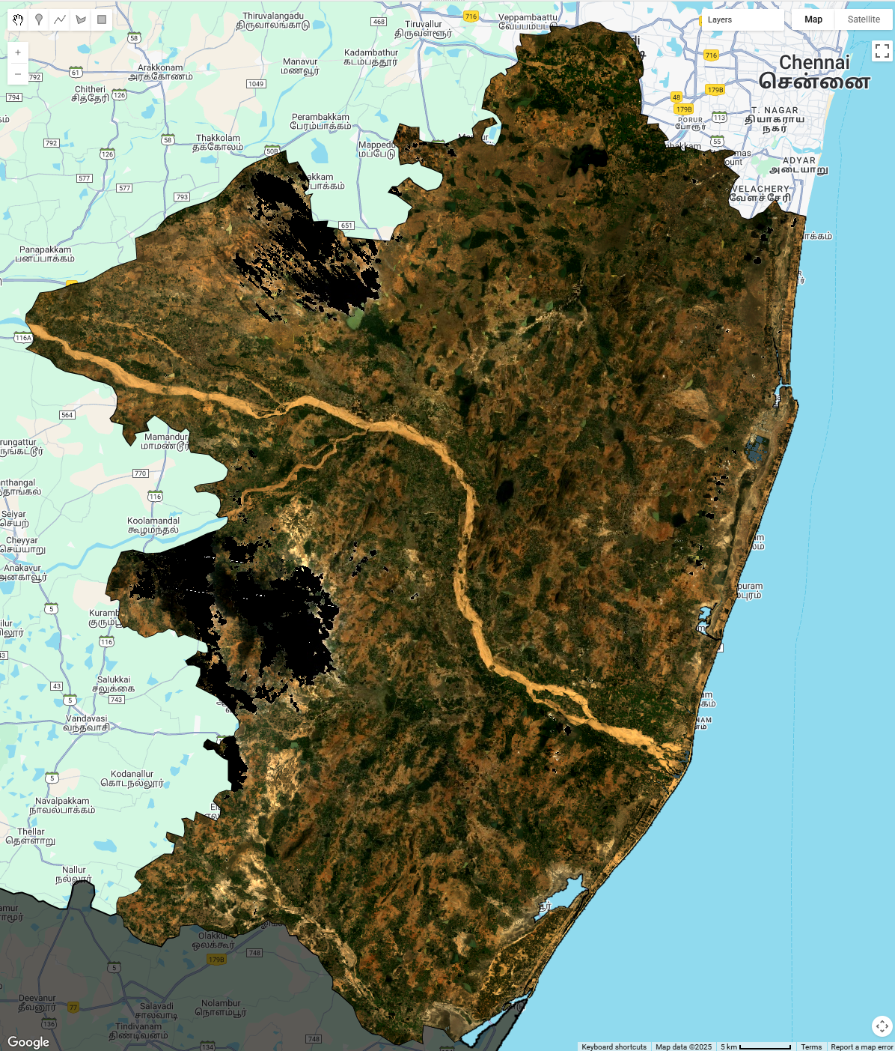
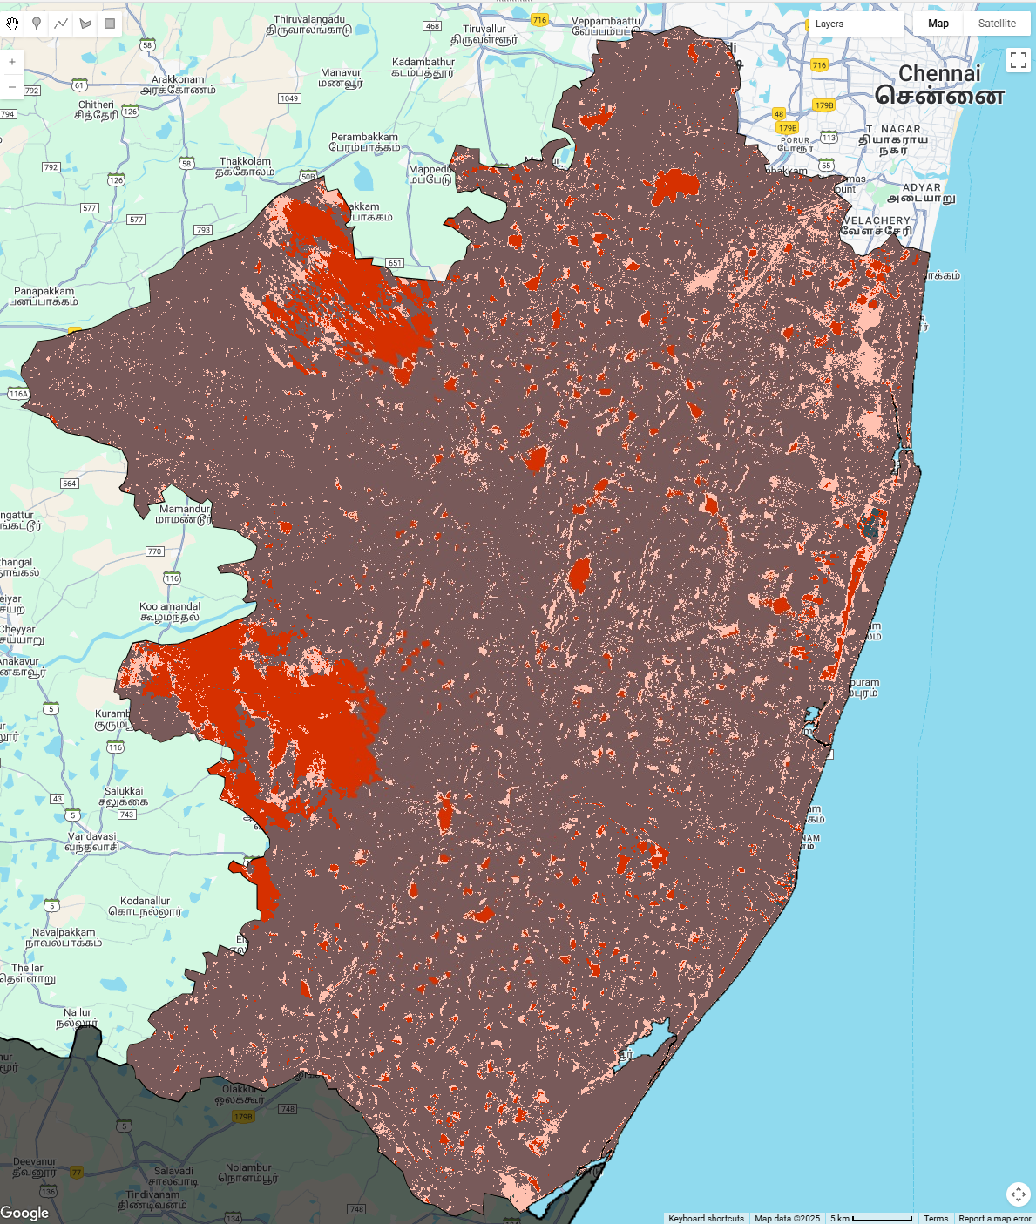
TN_2 in 1990
Missing image pixels are counted as aquaculture

Slide 3
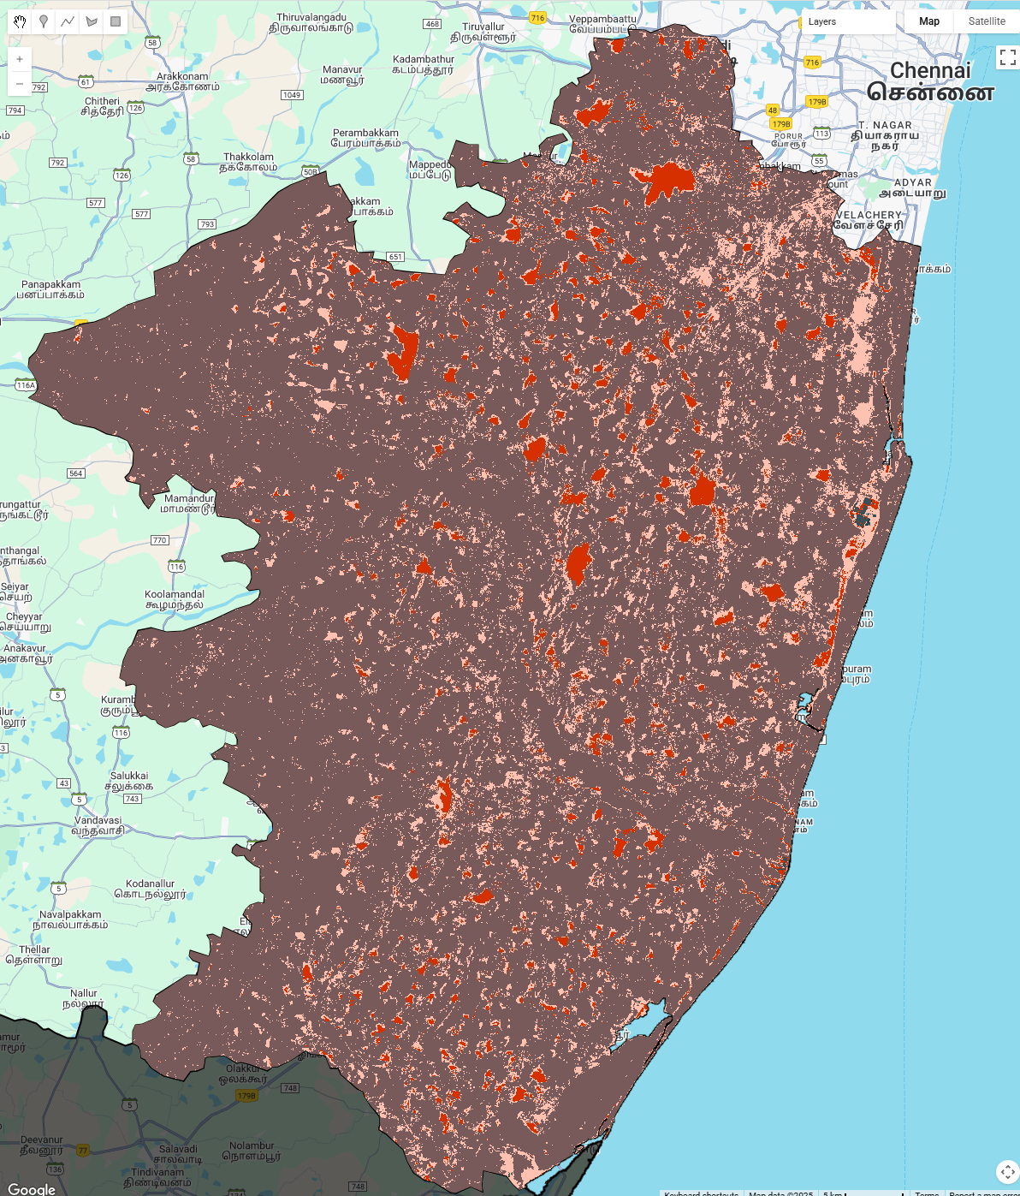
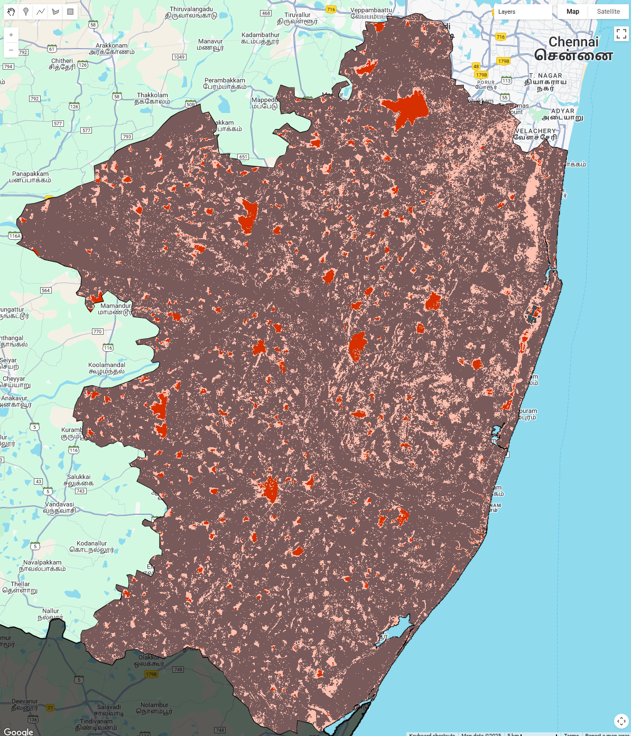
TN_2 in 1991, 1992
Waterbodies counted as aquaculture

Slide 4
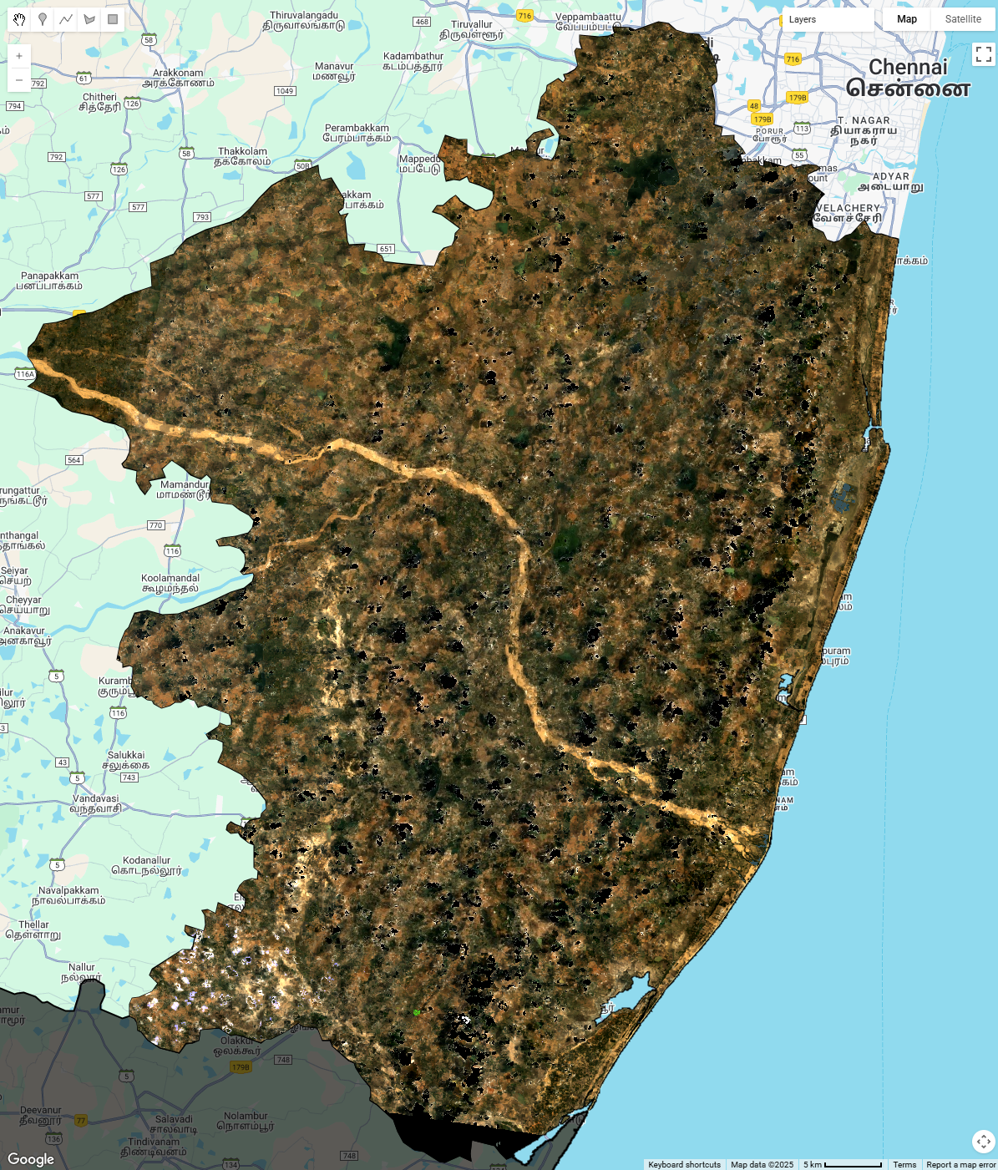
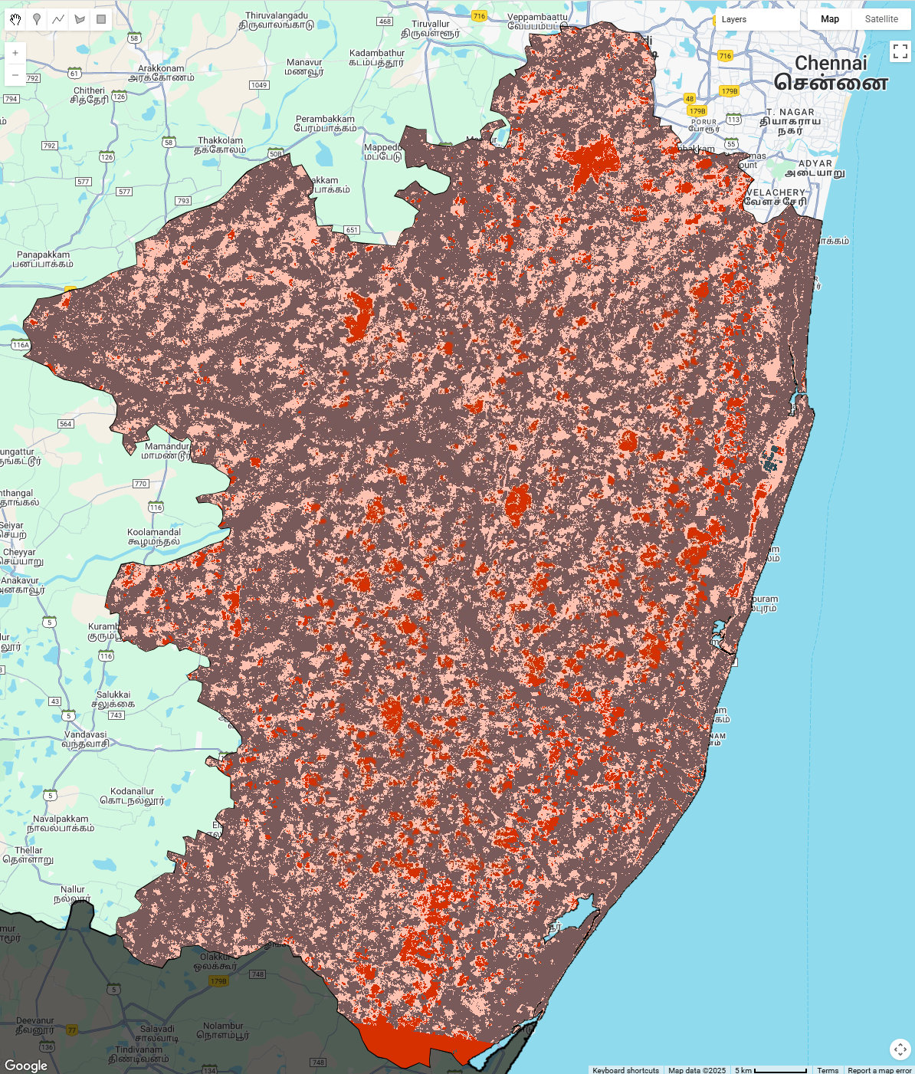
TN_2 in 1994
Missing pixels and waterbodies counted as aquaculture

Slide 5
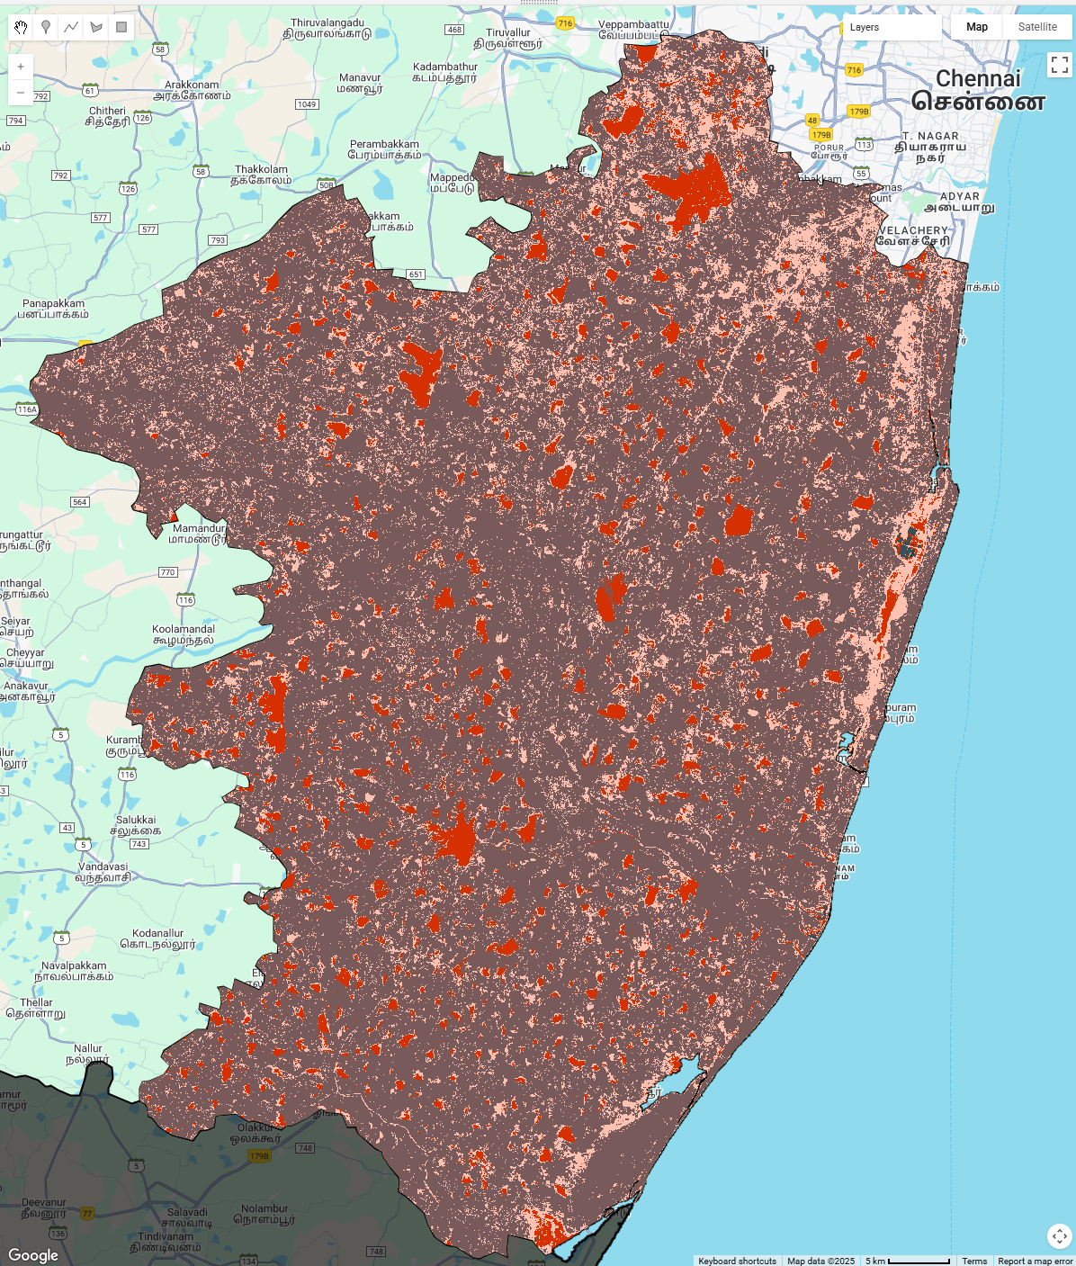

TN_2 in 2008 and 2010
Capturing water bodies as aquaculture

Slide 6
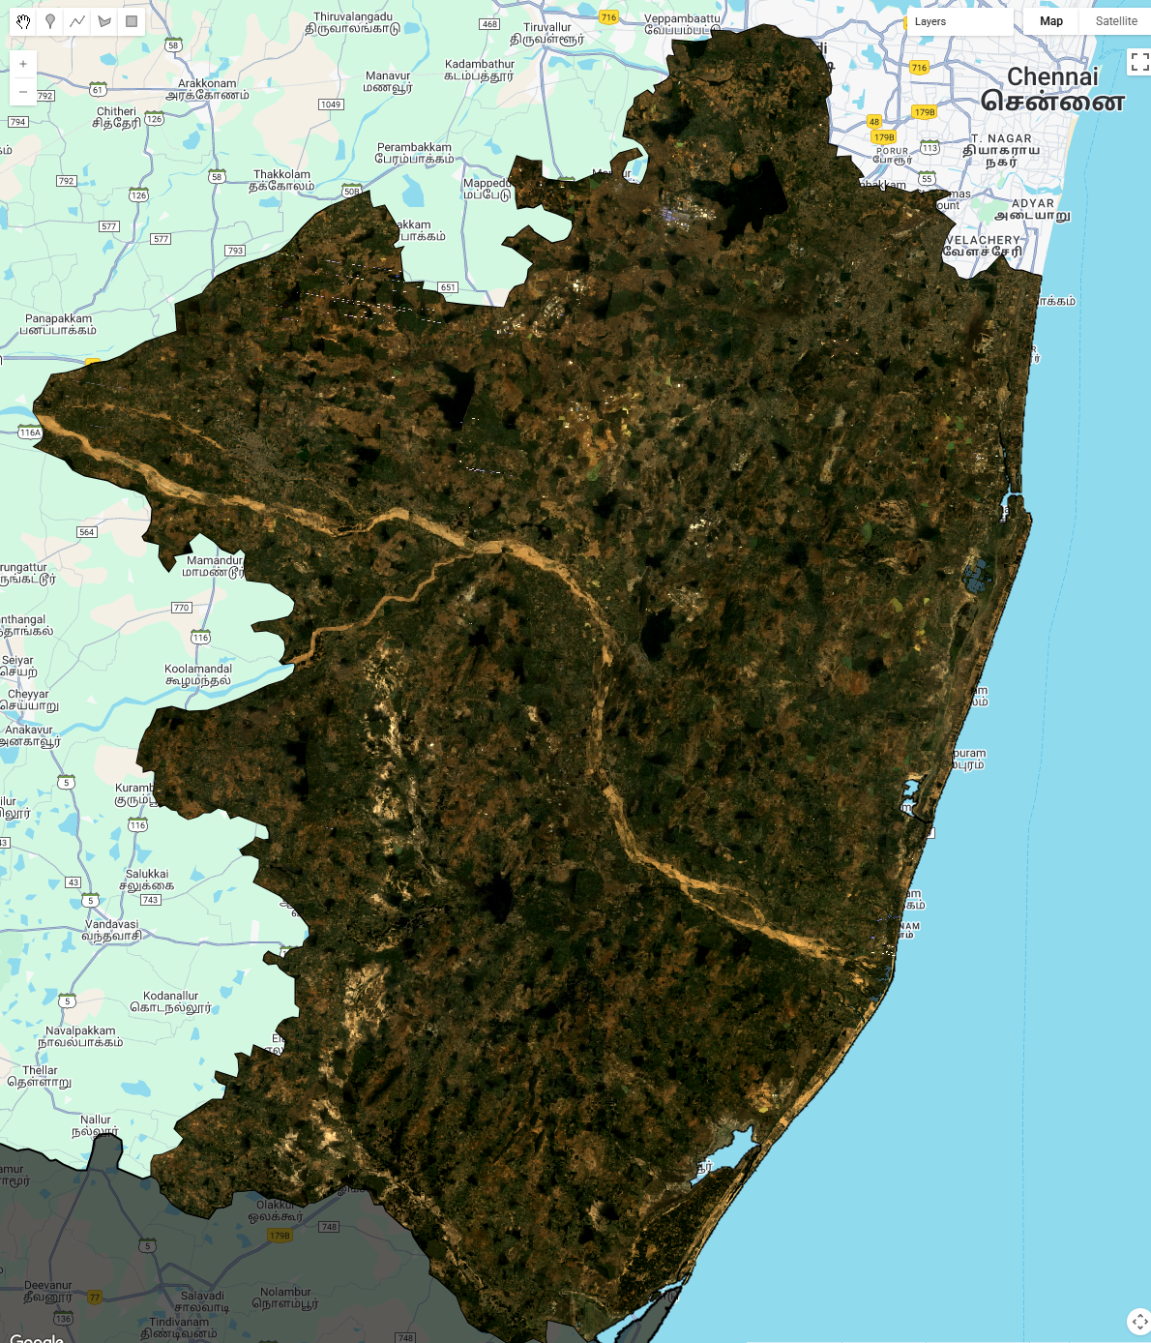
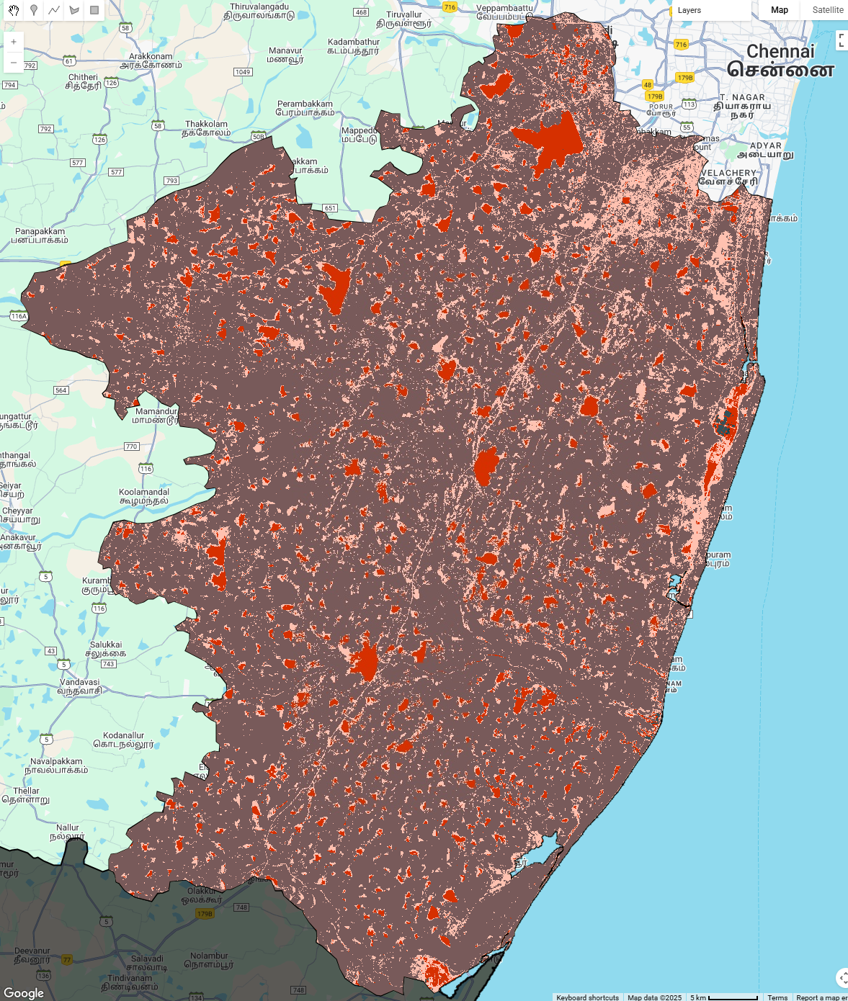
TN_2 in 2009
Capturing water bodies as aquaculture

Slide 7
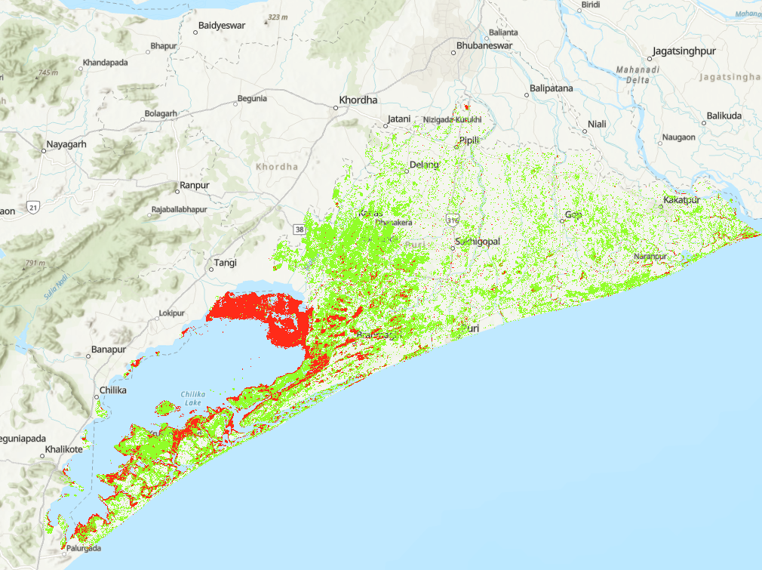
OD_5 in 1991
Capturing a water body (Chilika Lake) as aquaculture (note: they do practice aquaculture in it but it is not a pond)

